Slide 1


BC Attaching Cricket Club (BATCC)
AGM 2026
24.10.2026
https://batcc.de/

Slide 2


Agenda
S.No | Agenda | Presenter | Start | Duration
1 | Welcome & Opening remark | Zeeshan | 17:00 | 5 min
2 | BATCC - 1 - Captain report | Vineep / Amit | 17:05 | 5 min
3 | BATCC - 2 - Captain report | Bhavin / Venkat | 17:10 | 5 min
4 | Financial Health | Ankit | 17:20 | 10 min
5 | Selcom | Sasi / Sanjeev | 17:25 | 5 min
6 | Infrastructure - Investment update | Zeeshan / Ashish | 17:30 | 5 min
7 | Selcom Candidate - Pitch | Sasi, Shakir, Minhaj | 17:40 | 10 min
8 | Selcom Election & Result | Sankara | 17:50 | 10 min
9 | Announcement | - | 17:55 | 5 min
10 | Awards and Recognition | - | 18:10 | 15 min
11 | Closing Remarks | Zeeshan | 18:15 | 5 min
Promotion Party

Slide 3
2026 Season- Captain Reports
http://batcc.de/

Slide 4
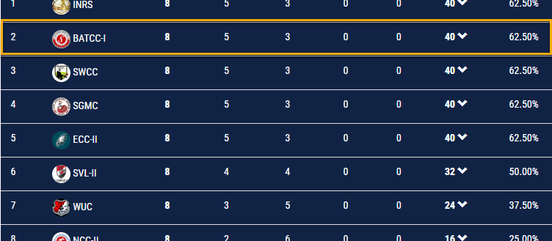
Troopers Report
Captain: Vineep Bhat / Amit Desai
Season Highlights
MAJOR MILESTONE
Achieved promotion to the Bundesliga.
Squad Balance
Successfully combined youth and experience.
Competitive Edge
Delivered strong, consistent performances without relying on individual players.
Key Challenges & Areas for Improvement
Consistency: Address losses under pressure by building greater reliability throughout the entirety of matches.
Crease Presence: Cultivate resilience by learning from past mistakes, spending more time at the crease, and extending innings.
Bowling Discipline: Maintain disciplined lines and lengths, executing deliveries according to the set field.
Fielding Standards: Elevate overall fielding performance to meet higher competitive benchmarks.
Team Unity
Demonstrated exceptional team spirit and collective resilience.
Key Victories
Secured crucial wins against top-tier opponents, including ECC II and NCC II.

Slide 5
Vision & Plans for 2027
Strategic Roadmap & Key Objectives
emoji_events
01
groups
02
shield
03
On-Field Ambitions
Capitalize on 2026 momentum by targeting a top-tier finish in the T20 league and aim to play competitive Cricket in BL and target for top finish in the league.
Squad Performance
Enhance consistency in both batting and bowling by cultivating reliable all-rounders and targeted death-over specialists.
Fielding Standards
Need to work to get our Fielding standards up to the mark.
trending_up
04
diversity_3
05
military_tech
06
Talent Development
Deepen our roster by progressively introducing emerging players from the broader club setup.
Culture & Community
Foster team cohesion through regular social gatherings and post-match events.
Club Representation
Would love to have more players from the club represent BCV and Leagues organised by BCV.

Slide 6
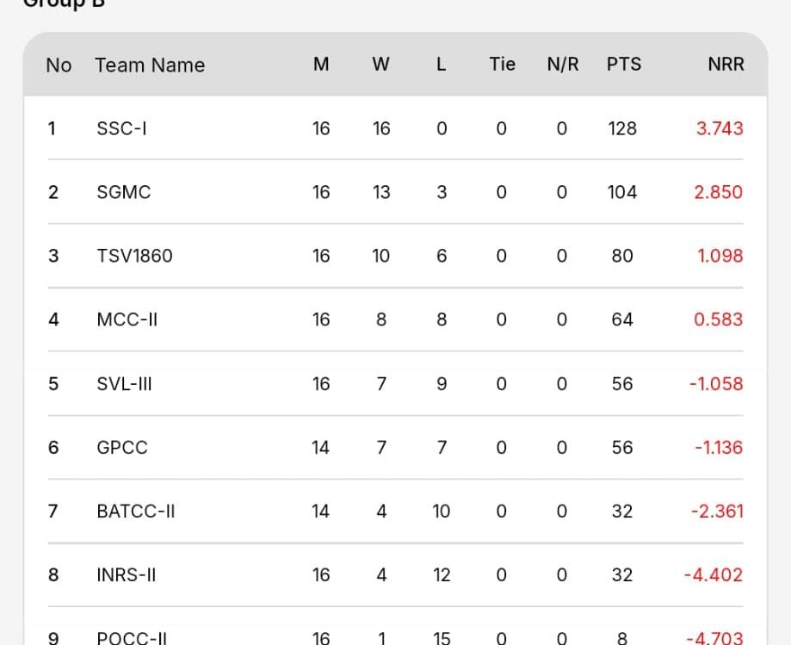
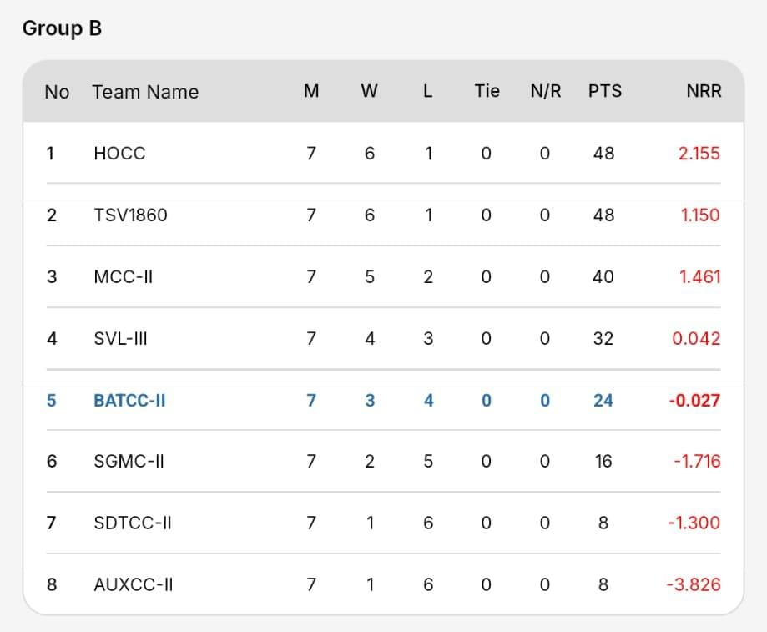
Challengers Report
Captain: Bhavin Solanki / Venkat
Standing and Summary in T20s:
Key Challenges & Areas for Improvement
Batting: Inconsistent batting performances led to many of the losses this season.
Fitness: Fitness in cricket is essential for improving stamina, strength, speed, and agility, helping players perform consistently throughout the match.
Bowling Discipline: Maintain disciplined lines and lengths, executing deliveries according to the set field.
Fielding Standards: Elevate overall fielding performance to meet higher competitive benchmarks.
Standing and Summary in ODIs:
Top Performers for Challengers:
Best batting Performances: Arjun, Sanju.
Best Bowling Performances: Minhaj and Shakir.
Best Fielding: Abhijeesh and Omer.
Season Highlights
Only BATCC team to beat SDTCC at their home ground.
Exceptional Batting Performance shown by Minhaj and Abhijeesh at the later end of the Innings against SGMC.
Incredible 5-wicket haul for Minhaj at SDTCC.

Slide 7

Areas of improvement:
Convert a good start in to a good total
Establish a new partnership after fall of wicket
Play according to the situation
Top Order Batting performance
Control the extras in the bowling
More attacking approach rather than defending
Punctuality and dedication
Goal for 2027: Qualify for the RL
Go Challengers!

Slide 8
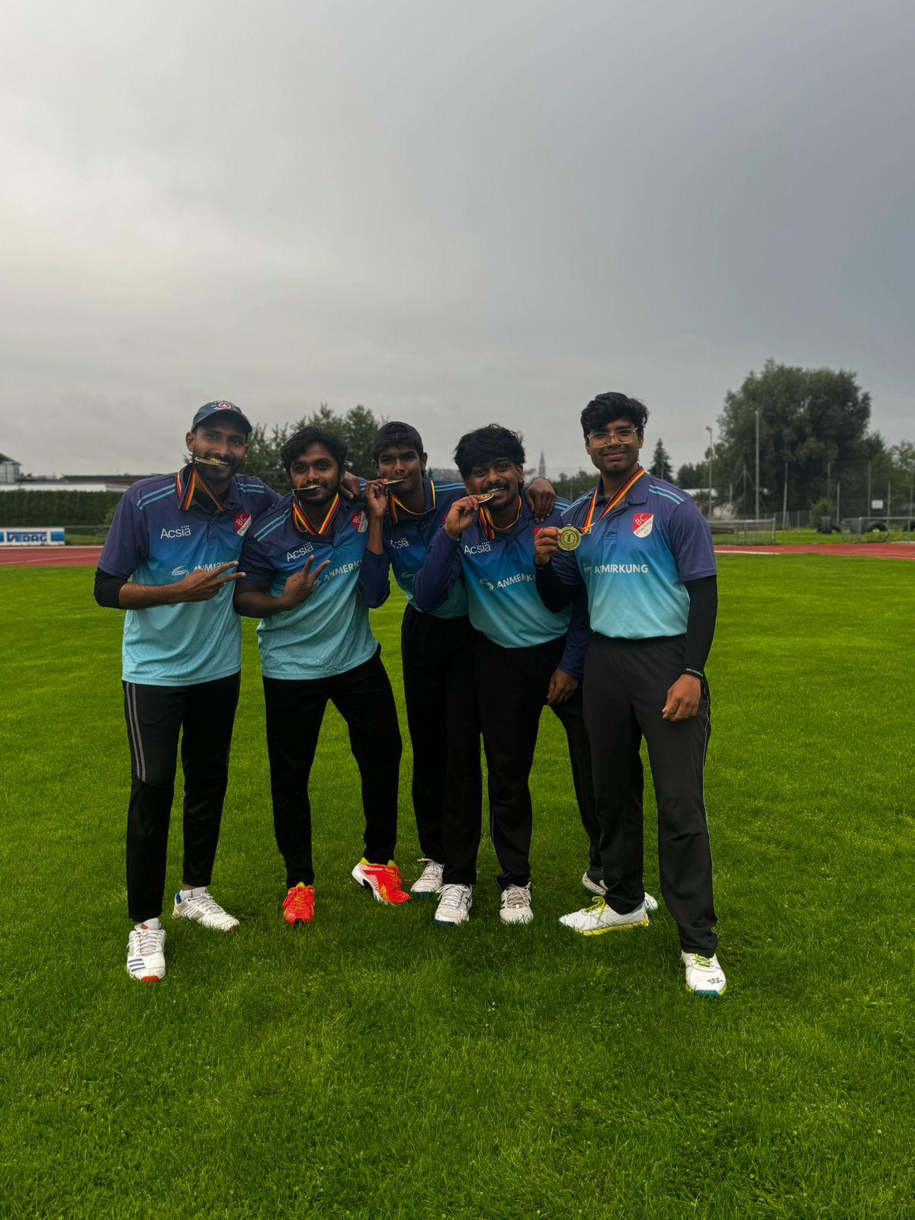
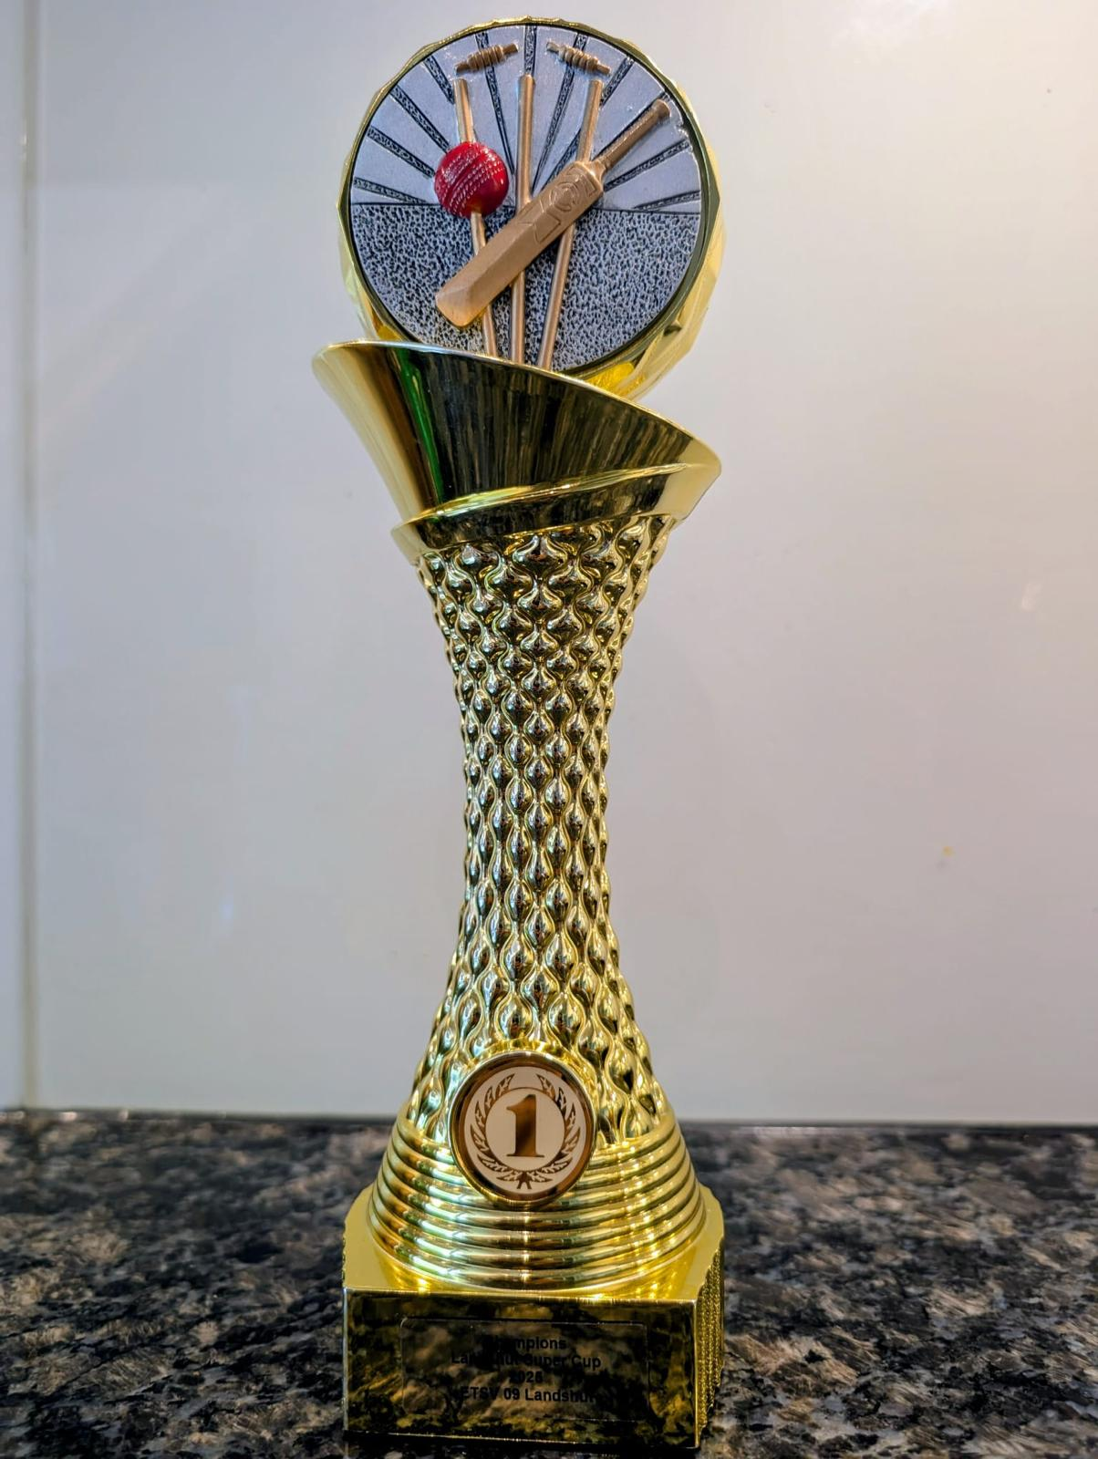
WINNERS! ETSV 09 Landshut Tournament

Slide 9

Financial Overview
http://batcc.de/

Slide 10
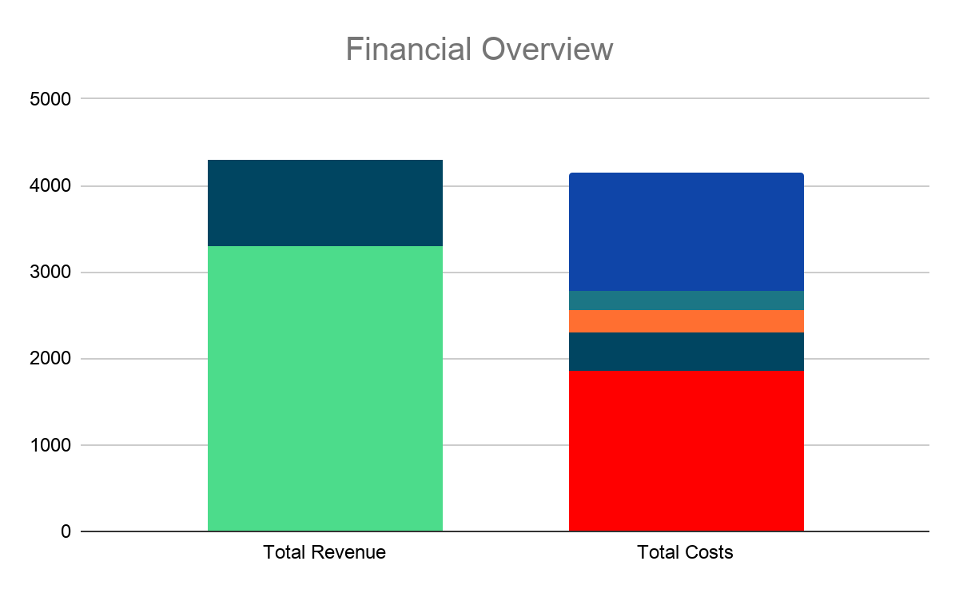
Financial Overview Year 2026
Total Revenues:
  Membership fees +3300€
  Acsia sponsorship +1000€
  Pitch rent +571,42€
  Total Revenue Generated +4871,42€
Total Costs:
  BCV Fees -1850€
  Ball costs -441€
  DCB Fees -275€
  Club tournaments -220€ (Gilching + SGM)
  Shoes costs -640€
  Food Pilgirms game -217€
  AGM party costs -500€
  Total Expenses -4143€
Year-end balance +728€ (-1177€ YoY)

Slide 11




SELCOM
http://batcc.de/

Slide 12

Selcom Members - Sanjeev, Sasi, Captains
2026 Report:
  Team 1:
Qualify for Bundesliga or stay on top 4 in table - Advanced to Bundesliga
Team 2:
  Qualify for regionalliga - Not met.
Key takeaways:
  Team 1 and Team 2 exceptional individual contributions
  Fighting spirit
Improvements:
  Bowling and Fielding discipline
  Focus on growth of club
2027 Goals:
  Recruit new members and Plan for 3 teams
  Team 1 Goal:
Sustain in Bundesliga
Same t20 and t50 team combination
Team 2 Goals:
  Qualify for regionalliga
  Same t20 and t50 team combination
Team 3 Goals:
  Growth of club talent pool
  Exposure to matches in verbandsliga
  Same t20 and t50 team combination
Note : This is the draft plan and it will be finalised post SELCOM selection

Slide 13
Infrastructure
http://batcc.de/

Slide 14
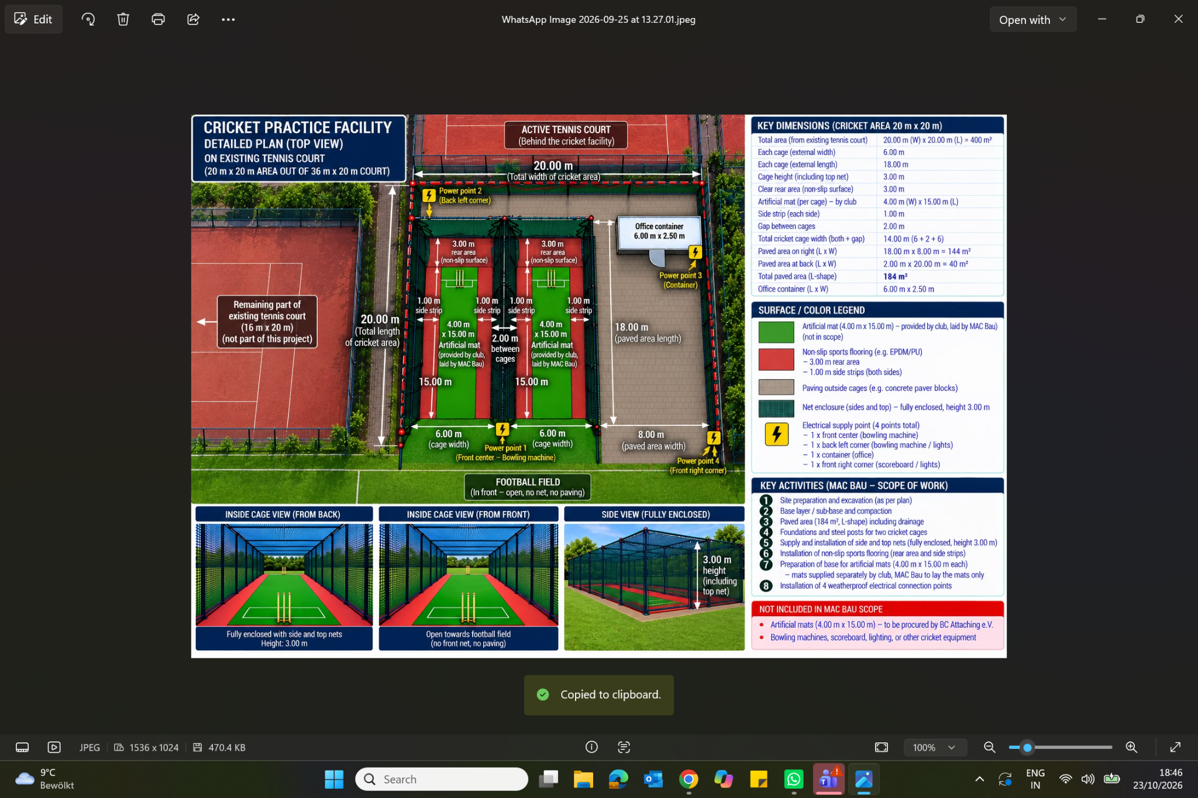

Slide 15

http://batcc.de/

Slide 16
Selcom - Candidates
Sasi Kiran Alur
Mohammed Shakir
Muhammed Minhaj Madathodi
Q/A session

Slide 17



Please Scan and Provide your votes
***Voting will be anonymous and only final results will be announced in the end***

Slide 18
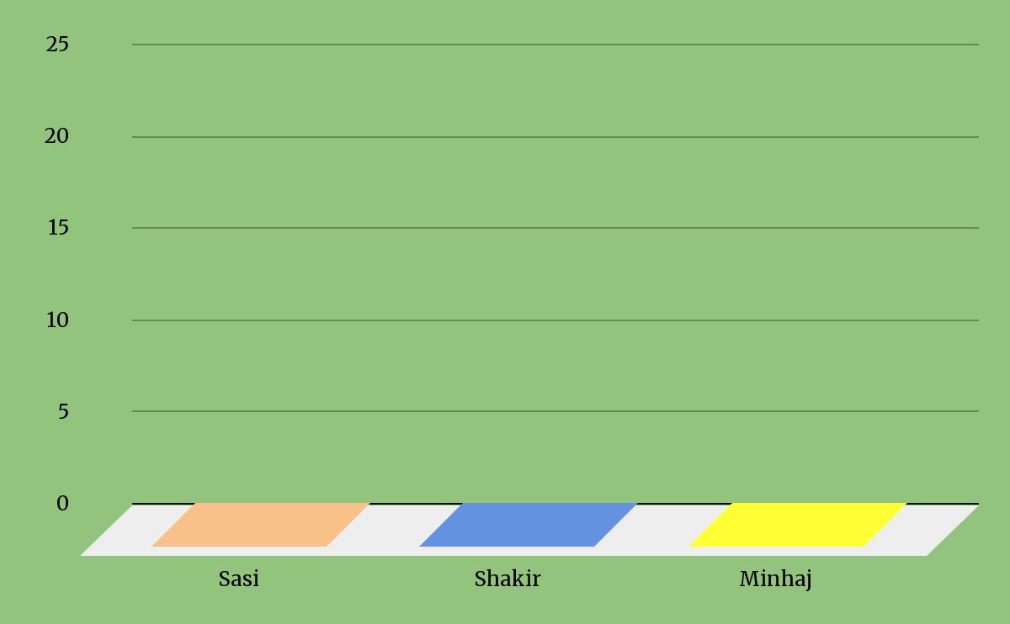
Result

Slide 19

Best Performance Awards 2026
http://batcc.de/

Slide 20
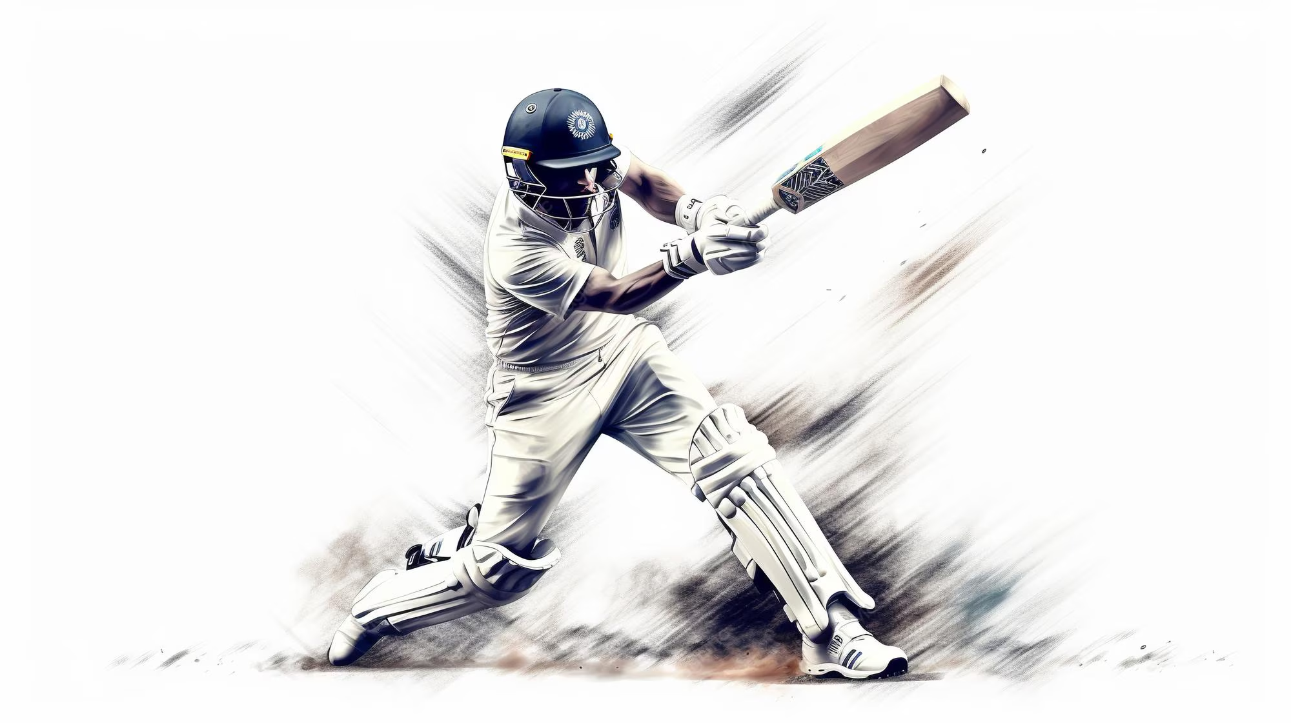

Best Batsmans for the Season
One Day Cricket
T-20 Cricket
ROHIT VERMA
MUHAMMAD TALHA
Team 1 :
Team 1 :
SANJEEV SIVARAMAN
ARJUN NADOL
Team 2 :
Team 2 :

Slide 21
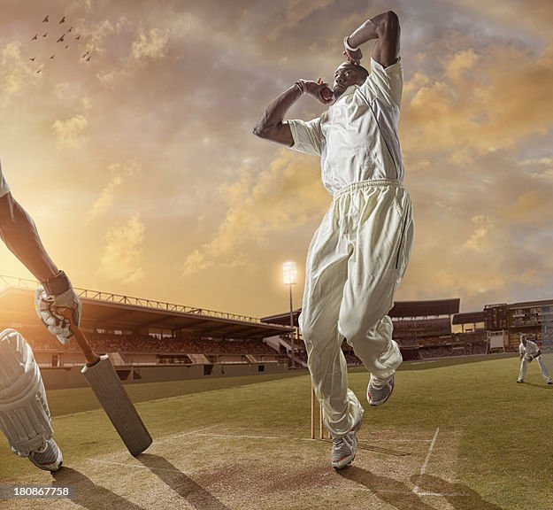
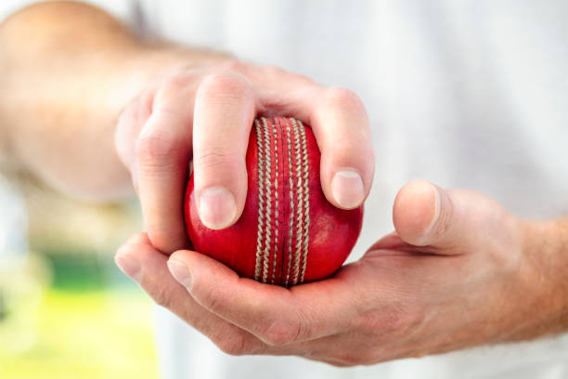
Best Bowlers for the Season
One Day Cricket
T-20 Cricket
ADBUL NASIR KUNNARI
AMIT RAJENDRA DESAI
Team 1 :
Team 1 :
MUHAMMED SHAKIR
MUHAMMED MINHAJ MADATHODI
Team 2 :
Team 2 :

Slide 22


Best All-Rounders for the Season
Team 1 :
Excellence in SoMo and Recruitment
MD ESSA
NITESH SINGH
Team 2 :
Venkat Vinay
Promising Talents
Team 1 :
Pillar of Support
HARIS ALI
ABHIJEESH MAROLI
Team 2 :
PARAS JAIN

Slide 23
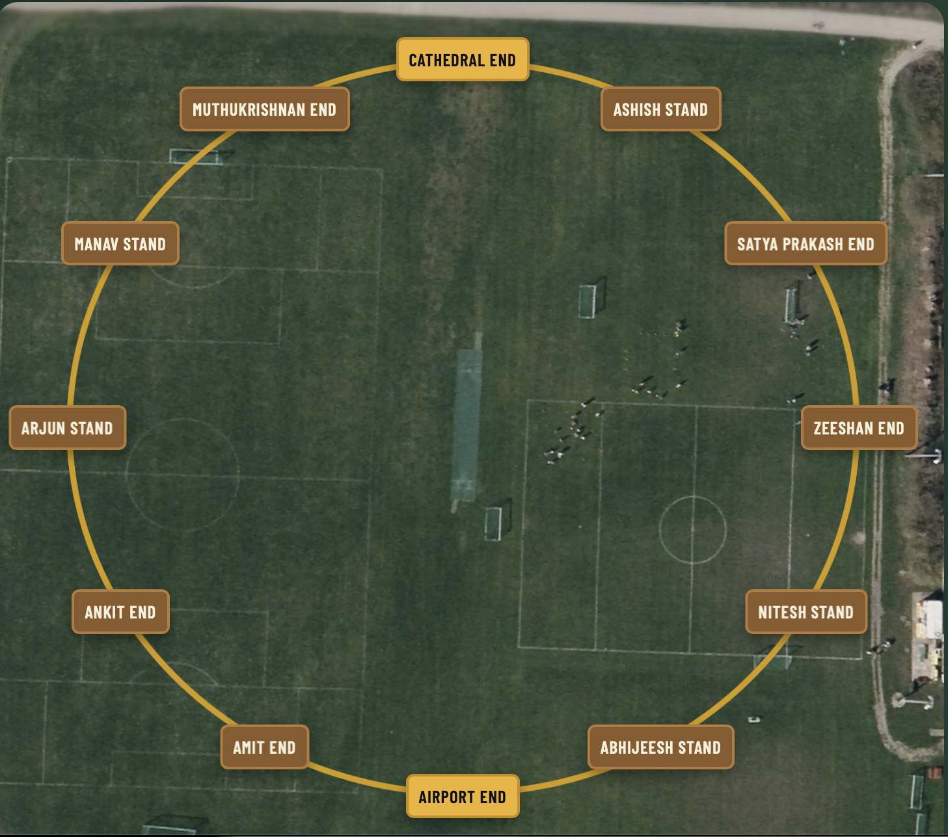
Voluntary Contribution
https://batcc.de/fame_corner
ASHISH SATPATHY on TOP!
Do not forget to complete 10 voluntary hours to reduce your excess fees.

Slide 24


Once again a big thank you to Robert for being here today and we appreciate your continuous support for the cricket department.
Wish you all success in 2027

